Slide 1
PATENT OF DI BRINA EXTERNAL COMBUSTION MACHINE

Slide 2
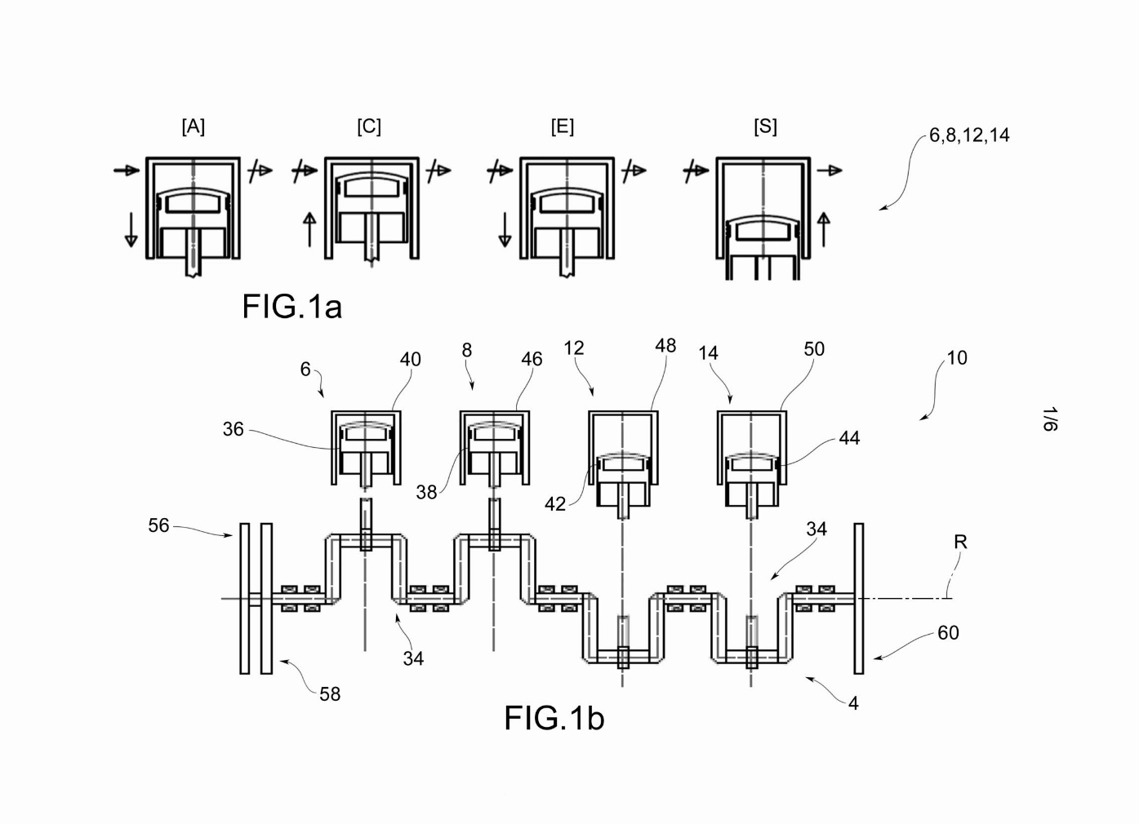
The machine represented here essentially consists of four cylinders with relative pistons because there are four phases that each cylinder carries out: intake, compression, expansion, exhaust. Fig.1a. To produce mechanical work, a high-yield chemically inert closed-cycle working gas is used and the horizontal arrows at the top of the cylinders indicate the respective electric valves for gas inlet and outlet.
Fig. 1b shows the crankshaft in a possible configuration aimed at carrying out the phases in all cylinders. Obviously it is also possible to make different configurative choices if imposed by mechanical requirements. The discs n. 56 and 58 are optical (or possibly other) and are used to generate input signals for the CPU that will have to manage the on-off of the aforementioned electric valves. Disc no. 60 is instead a flywheel to which a traditional type starting system is connected.

Slide 3
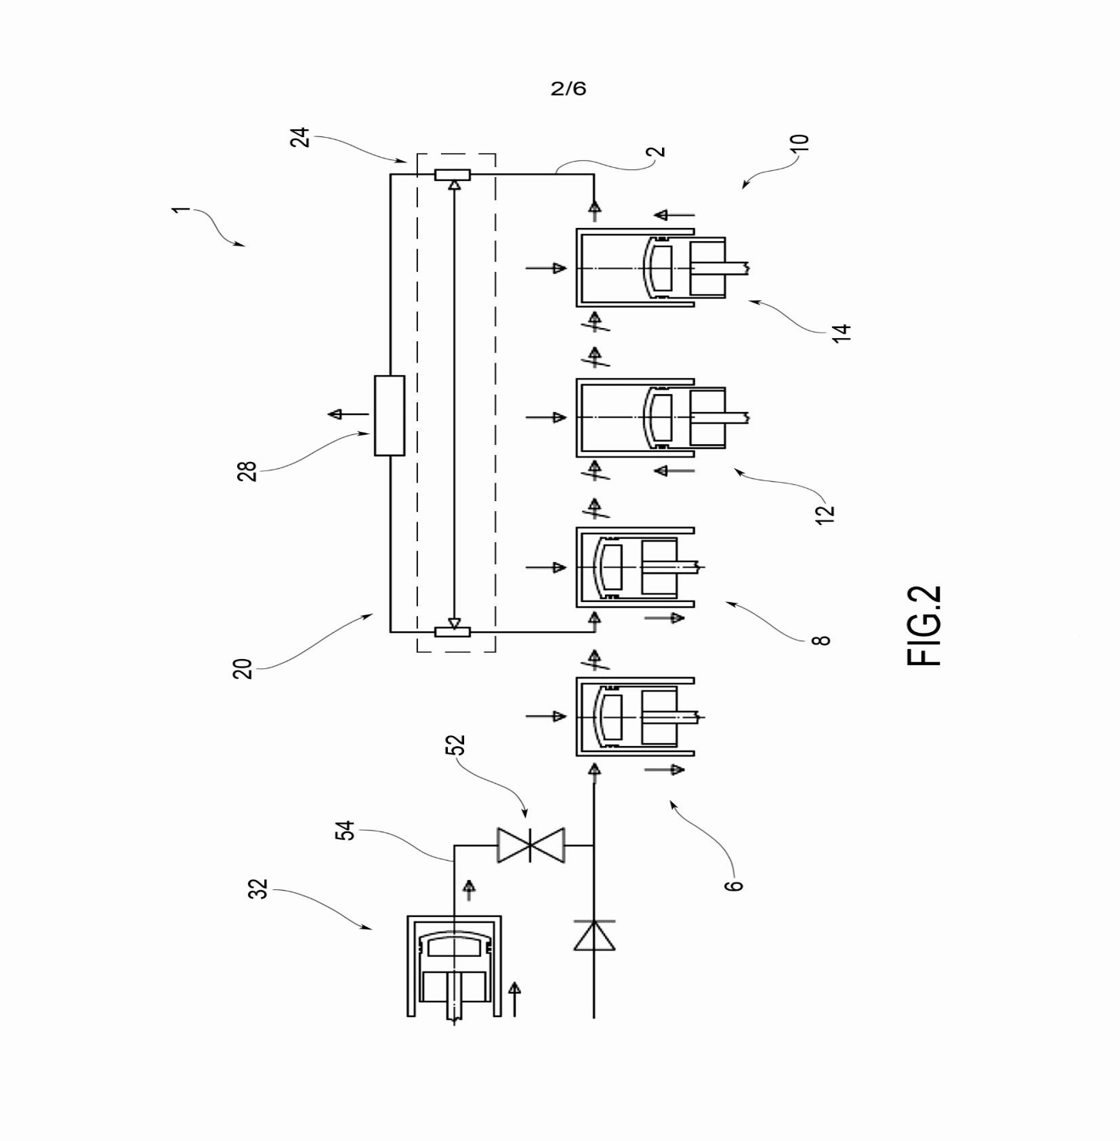
In this slide we can see the system in the initial configuration required for departure. The fifth cylinder (no. 32) contains the working gas which is sent to cylinder no. 6 via valve no. 52. In fact, at the initial instant, cylinder no. 6 simulates gas compression. On startup, the starter motor will simulate the expansion work in it and will compress the gas in cylinder no. 12 for the future true expansion and therefore for the startup of the entire system. The piston of the no. 32 cylinder will remain stationary at the end of the stroke for the whole operation of the machine and the valve no. 52 after the passage of the gas will remain closed. The vertical arrows on the cylinder heads represent the external heat sources. Among the cylinders n. 10 and 8 there is a connection for the gas exchange (no.20). At no. 24 is showed an internal heat exchanger for the recovery of a part of the waste heat. This is after the gas has passed through the external exchanger (no. 28) to return to the initial state. It can easily be shown that the gas exchange zone between the two cylinders constitutes a single and physically isolated environment from the point of view of the forces and moments applied to introduce further quantities of working gas in a calibrated way.

Slide 4
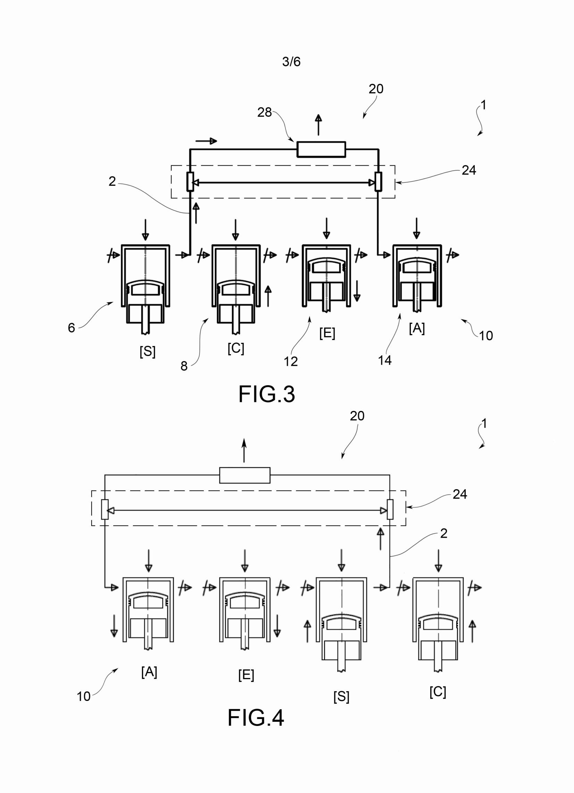
In this slide we can see the realization of two of the phases following the start of the machine. In fig. 3 it is possible to observe the phase of gas compression in cylinder n.8 and expansion in n.12. On the other hand, the gas is exchanged between cylinders n.6 and n.10 in the manner already described.
In fig. 4 instead we have the expansion and compression phases in the cylinders referred to letters [E] and [C] and exhaust in the cylinders with the letters [S] and [A].

Slide 5
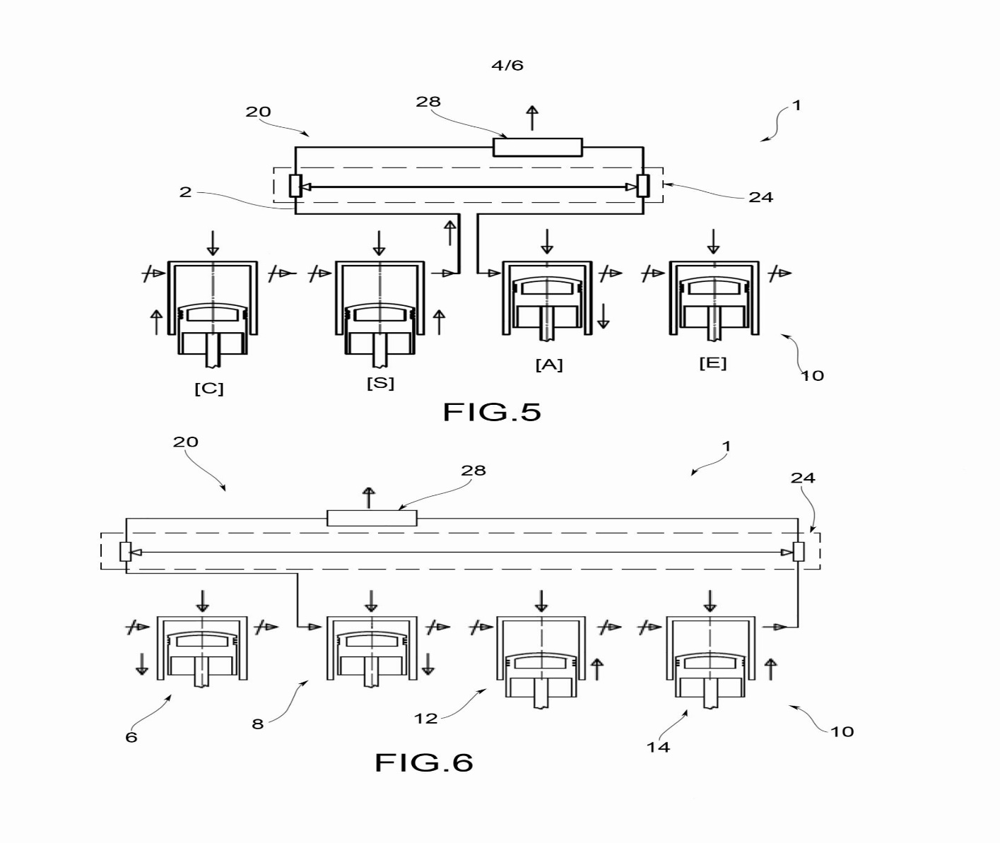
In this slide we can see the last frame of the overall cycle of the machine (fig. 5). In figure 5 we see at the letters [C] and [E] the compression and expansion phases; instead in letters [S] and [A] the exhaust and intake phases with the heat exchanger system.
In fig. 6 we can see the same situation represented in figure 2 but without the fifth cylinder on the top left (n.32) for the reasons already mentioned. It represents the return to the first configuration from which to restart for the execution of the subsequent phases in an infinite cycle. In the shutdown phase, the reverse procedure takes place with respect to that described for fig. 2 by using the starter engine.

Slide 6
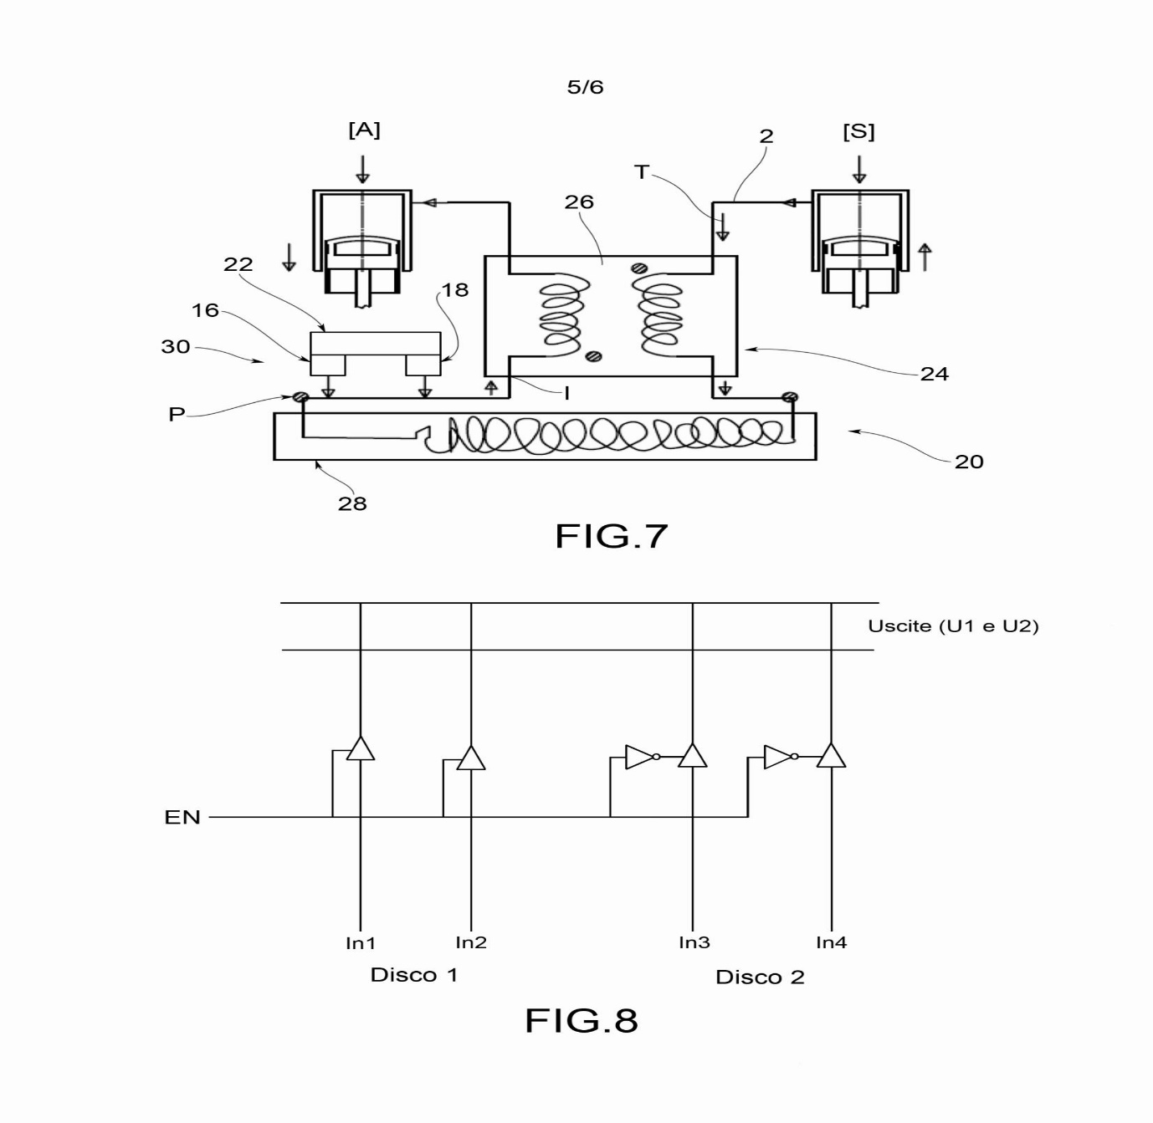
Fig. 7 shows the heat exchanger system. The internal exchanger is conceptually comparable to a single-phase transformer of the electrotechnical type (no.24 and 26). In it, a portion of the waste heat is recovered from the gas sent to the cylinder in the suction phase [A] after it has been completely cooled in the external exchanger (no. 20). Point P represents the input of injection in the acceleration phase (or drawing in the deceleration phase) of the working gas. The block referred to numbers 30, 16, 22 and 18 represents a pressure equalizing device with relative accessories to ensure the same quantity of gas in the three internal areas of the machine.
Fig. 8 shows a multiplexer, that is a circuit to select the signals coming from the disks of fig. 1b. When the signal is high at the EN terminal, Disc1 is selected on the contrary for Disc2. The selection takes place after a complete turn of the crankshaft as each of them manages the execution of two complete phases or two of the frames mentioned above.

Slide 7
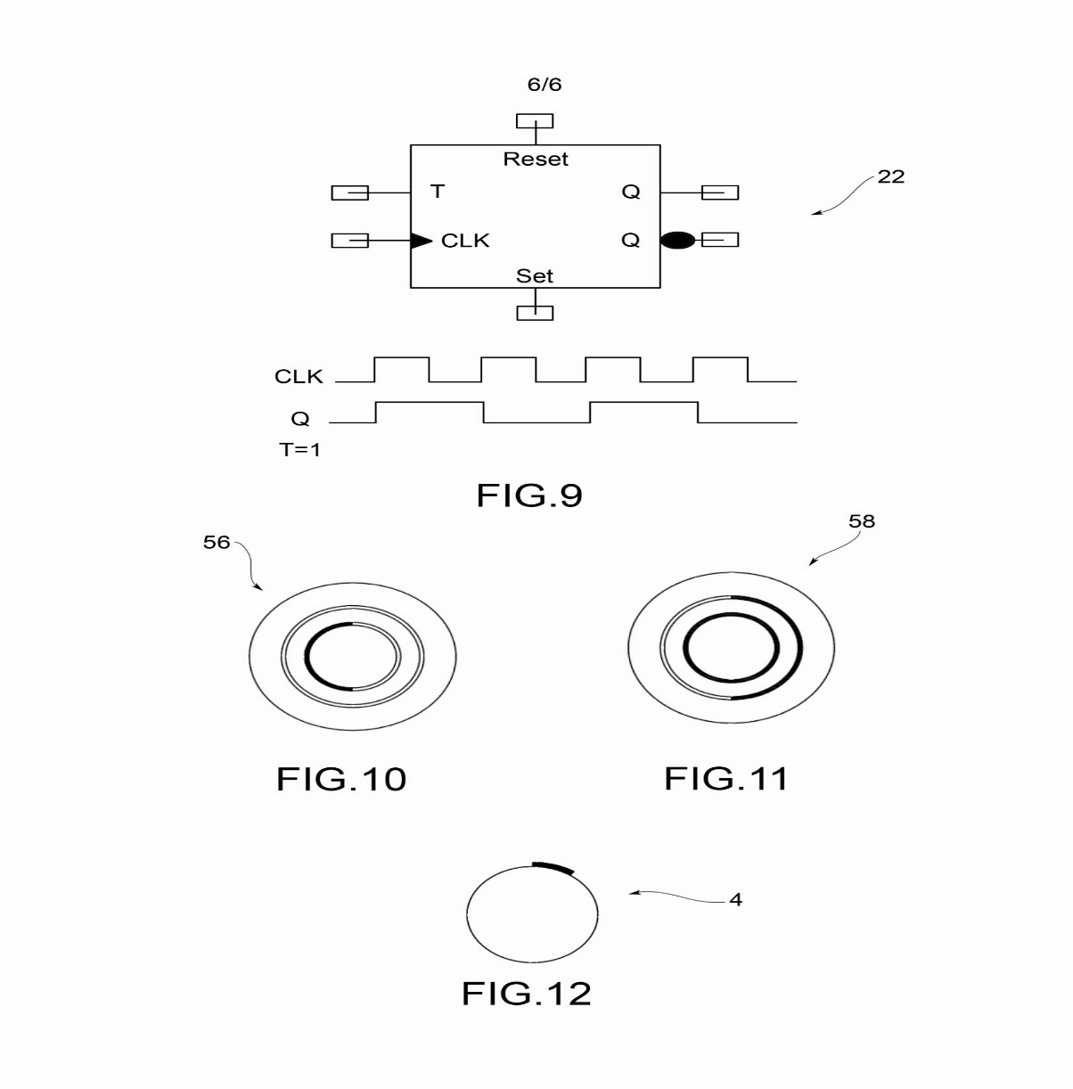
Figure 9 shows a T-type Flip-Flop. During its operation, terminal T is set to a logic 1 state. The waveform represented is sent to the CLK terminal. Its frequency of is depending on the angular speed of the motor shaft and on which a magnetic band is glued (fig.12). In this way, through a suitable head or transducer, it is possible to generate the CLK signal visible in the figure. At the output Q of the Flip-Flop T we get the waveform represented with half frequency and which is sent to the EN terminal of the multiplexer.
In figs. 10 and 11 are showed the two optical disks (referred to fig. 1b) which generate the input signals to be sent to the CPU for managing the entire system. The parts in bold are the areas made transparent to allow the passage of the LED light.

Slide 8
MAIN ADVANTAGES OF THE MACHINE
1) Zero emissions.
2) High yield. With it it is possible to reach efficiency levels close to the theoretical one of the Carnot cycle.
3) Lack of destructive internal stress due to absence of outbursts.
4) Silence.
5) Use of advanced mechanics and possible use of non-metallic materials with high technological characteristics especially from the thermal point of view.
6) High energy density both in input and in output with powers that are completely comparable to those of a gas turbine and more.
7) High flexibility. The ease of use is comparable to that of any internal combustion engine.
8) Greater safety and less maintenance due to the lack of destructive stress compared to internal combustion engines and gas turbines.
9) Reduced overall bulk.

Slide 9
CHARACTERISTICS OF THE EXPERIMENTAL PROTOTYPE
Any experimental prototype should be created not only in order to demonstrate what has been patented but also to be used for study purposes so to be completed with the devices indicated in fig. 7. For these reasons as well as those of the cost of the prototyping itself, it is possible to think of making a machine with a total displacement of 2000 cubic cm and a maximum output power of 50Kw. The number of revolutions may vary from a minimum of 1000 rpm. to a max. of 3000 rpm. Using a fuel, the max. temperature on the cylinder heads should be around 400/450 ° C. Obviously, depending on the financial resources, these parameters can also be varied as they are only general indications of the project.
With regard to the commercial aspects, the uniqueness of the product and the absolute lack of comparable machines on the market should be noted. That said, it is obvious that the markets will be dominated by the first proposers of the product in the various sectors of use; for example, from automotive to energy production.

